Slide 1
di-vacancies

Slide 2
tri-vacancies

Slide 3
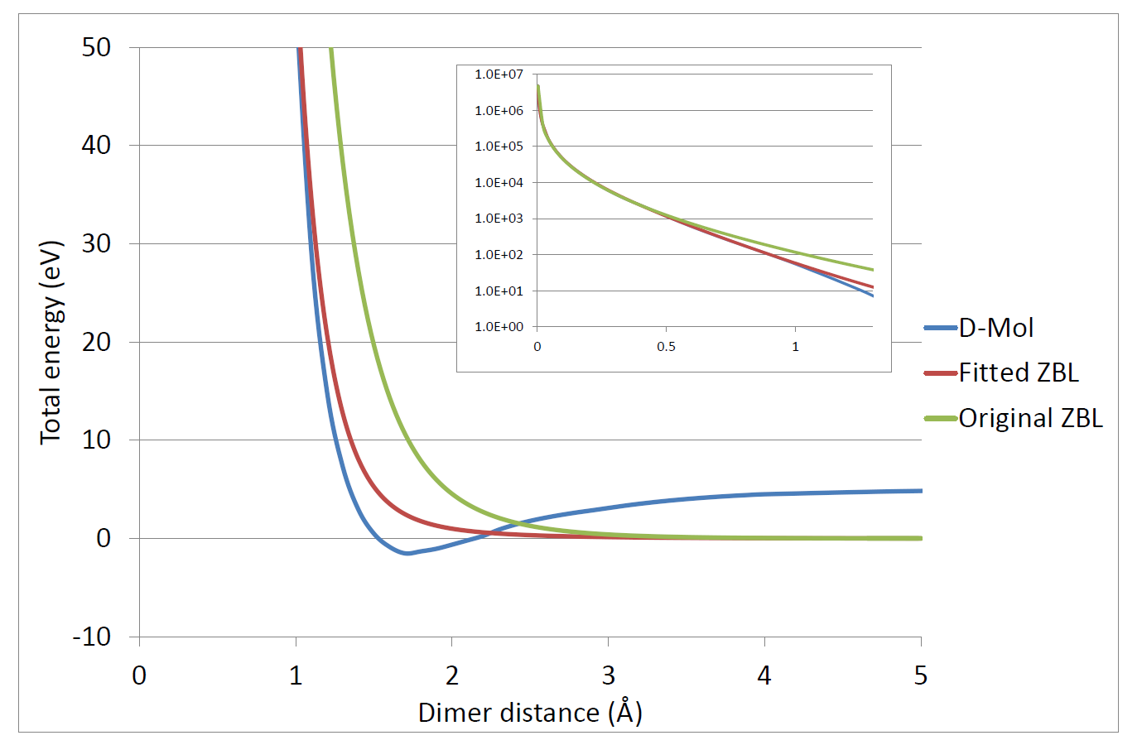
ZBL

Slide 4
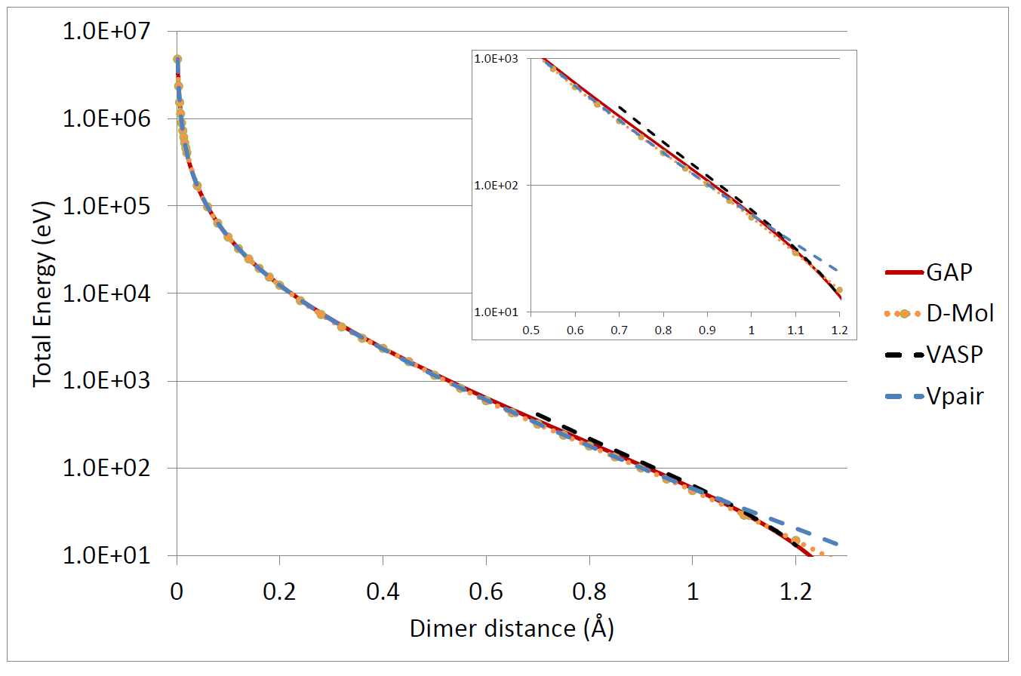
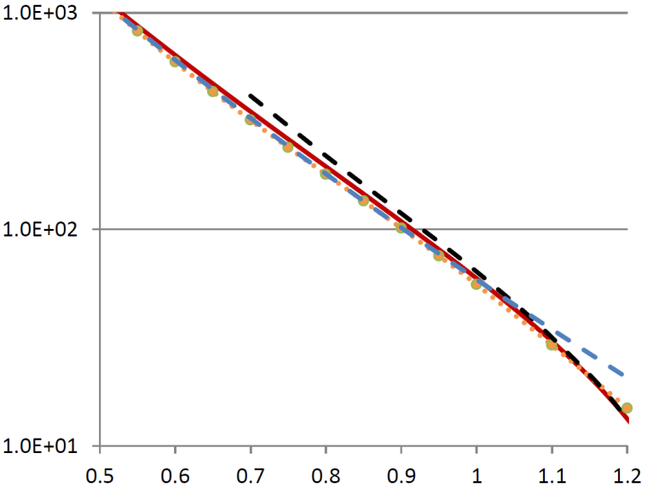
V_{pair}

Slide 5
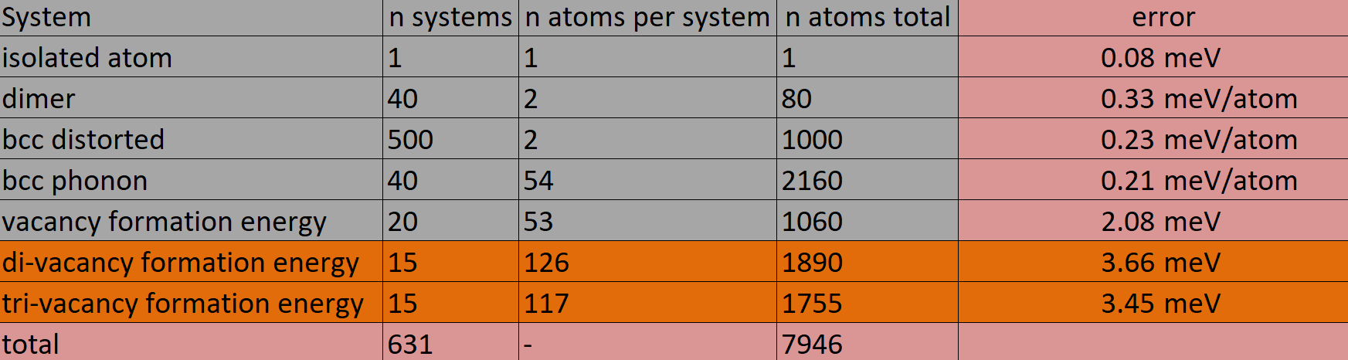
Training set
+
V_{pair}

